Slide 1

Careers for Architecture Graduates and Young Architects
STUDENT NAME:
VILORIA, JAMINA M.
20163667
SUBJECT:
BUSMAR11 EAE2
COURSE & YEAR:
BS ARCHITECTURE 4
INSTRUCTOR:
AR. RYAN M. BENAOE
PR-ACT-01

Slide 2







ARCHITECTURE
CAREER/JOB/PROFESSION
Pre-Design & Programming
Concept & Schematic Design
Client Liaison Architect / Consulting Architect
Programming/Briefing Consultant
Site Selection & Analysis Consultant
Feasibility/Pre-Feasibility Analyst
Urban/Physical Planner (w/ required credentials)
Research Architect / Post-Occupancy Researcher
Design Architect / Lead Designer
Project Architect (early phase)
Visualisation Specialist (3D/VR)
Computational Designer / Parametric Designer
Sustainability Strategist (early-stage)
Construction Documents
Architect of Record (AOR) / Architect-in-Charge of Practice (PH)
Specifications Writer
BIM Manager / BIM Coordinator
Code/Regulatory Compliance Consultant
Universal/Accessible Design Consultan
Comprehensive/Allied Services
Procurement & Tendering
Architectural Interiors Specialist
Site Development Planning Lead
Master Planning / Urban Design Architect
Historic Conservation / Heritage Architect
Security Planning / CPTED Consultant
Acoustic / Lighting Layout (architectural)
Design Development
Bid/Procurement Advisor
Contract Documentation Lead
Technical Evaluator / Tender Reviewer
Value Engineering Facilitator
Project Architect
Sustainability Consultant (LEED/BREEAM/Green Mark/BERDE)
Building Physics / Daylighting Analyst
Façade Designer / Façade Engineer (with allied creds)
Cost Planner (with QS collaboration)

Slide 3






ARCHITECTURE
CAREER/JOB/PROFESSION
Construction Phase (CA)
Construction Administrator / Contract Administrator
Site Architect / Clerk of Works (UK)
Resident Architect / Project Supervisor (jurisdictional)
Quality Assurance/Quality Control (QA/QC) Architect
Change-order & Claims Analyst
Construction Phase (CA)Post-Occupancy & Facilities
Post-Occupancy Evaluation Lead
Facilities Planning Architect
Building Performance Evaluator
Asset Information/BIM-FM Integrator
Regulation, Policy, & Academia
Regulation, Policy, & Academia
Building Official / Plans Examiner (qualified)
Codes & Standards Specialist
University Lecturer / Studio Instructor
Professional Examiner / Assessor
Government Planner/Heritage Reviewer
Practice & Delivery
Practice Manager / Studio Manager
Owner–Principal / Managing Architect
Project Manager (Architect) / Program Manager
Design–Build Architect
Design Technology Lead (BIM/VDC)

Slide 4

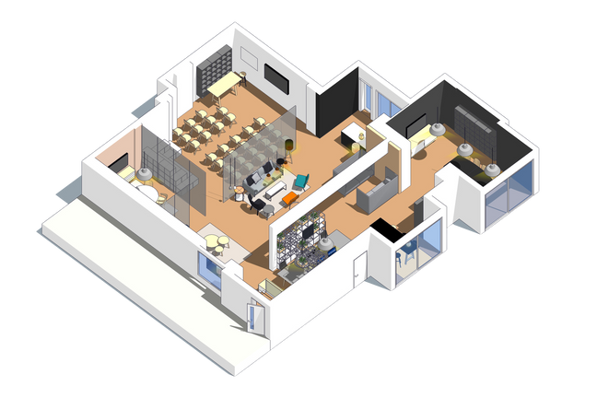


architecture
JOB AND ITS DESCRIPTION
PRE-DESIGN SERVICES
PLANNING SERVICES
Assesses whether a project is viable in terms of cost, site conditions, legal requirements, and sustainability. They prepare feasibility reports that guide the client before committing to design and construction.
Career: Municipal Planning and Development Coordinator (MPDC)
Works in the local government unit (LGU) to formulate comprehensive land-use plans, zoning ordinances, and development programs. They integrate social, economic, and environmental considerations into urban and rural planning.
ARCHITECTURAL DESIGN SERVICE
SPECIALIZED
ARCHITECTURAL
SERVICES
Career: Design Architect
Creates the conceptual and schematic design of buildings and structures. They translate the client’s needs into functional, safe, and aesthetically pleasing spaces, while complying with building codes and sustainability standards.
Career: Architectural Interiors Specialist
Focuses on the design of interior spaces, selecting finishes, lighting, furniture, and layouts to achieve functional and aesthetic goals. Ensures accessibility, safety, and human comfort in interior environments.
CONTRACT
DOCUMENTATION
CONSTRUCTION PHASE
SERVICES
Career: Specifications Writer
Prepares the technical specifications that define materials, finishes, workmanship, and standards for construction. They ensure that design intent is clearly translated into construction requirements.
Career: Construction Project Architect / Resident Architect
Oversees the construction site on behalf of the client. Monitors progress, ensures that contractors follow design documents, manages quality control, and addresses construction issues or revisions.

Slide 5
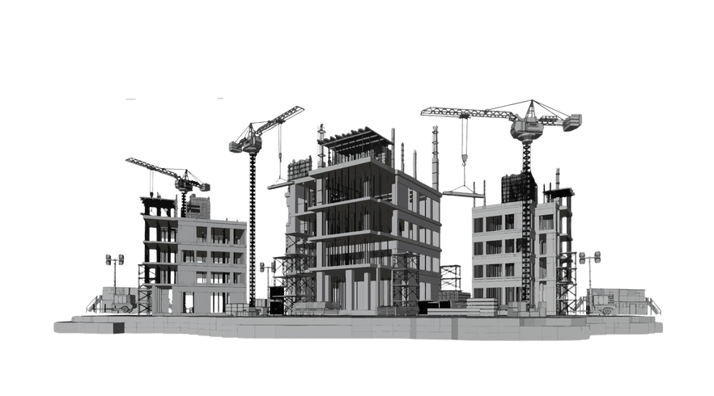



architecture
JOB AND ITS DESCRIPTION
POST-CONSTRUCTION SERVICES
Career: Facilities Planning Architect
Provides guidance on the operation, maintenance, and management of built facilities after turnover. Helps organizations optimize space use, sustainability performance, and long-term functionality.
ALLIED TECHNICAL SERVICES
Career: Site Development Planning Architect
Designs the external environment around buildings such as landscaping, parking, circulation networks, open spaces, and amenities—integrating them harmoniously into the site.
COMPREHENSIVE ARCHITECTURAL SERVICES
Career: Project Manager (Architect)
Acts as the single point of responsibility for planning, coordinating, and supervising all aspects of a project—from pre-design to post-construction. Ensures time, cost, quality, and scope targets are met.
PROFESSIONAL EDUCATION,
RESEARCH, AND POLICY
Career: University Lecturer / Studio Instructor
Teaches design studios, architectural theory, and professional practice in schools of architecture. They also mentor future architects, conduct research, and contribute to knowledge in architecture and urbanism.

